Slide 1
CraCKING THE CODING INTERVIEW
A Brief Summary of Questions

Slide 2
Chapter 2:
Linked LIst

Slide 3
Remove Duplicates: Removing duplicates from an unsorted linkedlist

Slide 4
Solution 1#: USING A HASH TABLE
REMOVING DUPLICATES

Slide 5
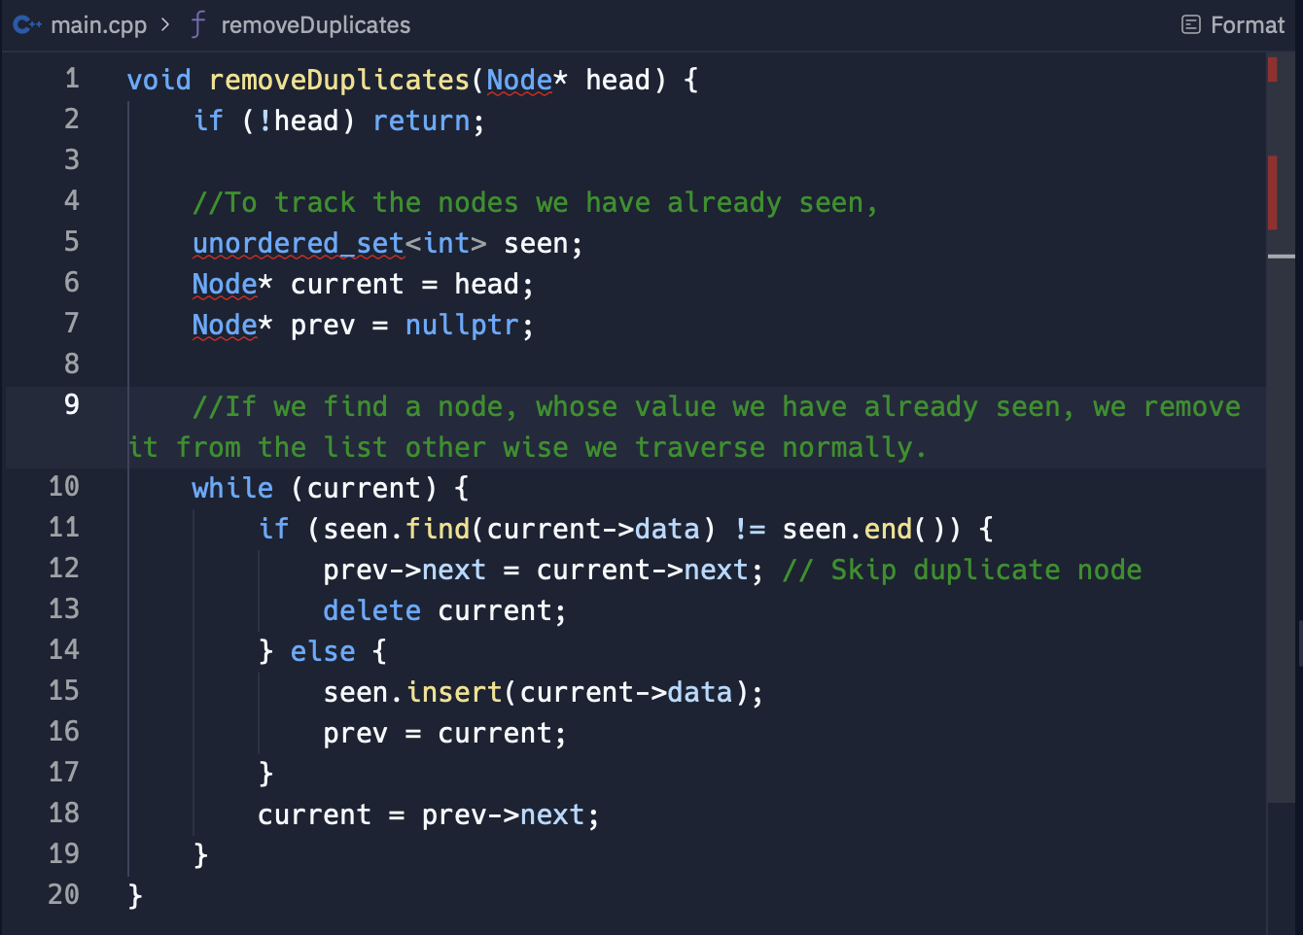
REMOVING DUPLICATES
TC = O(n)
SC = O(n)

Slide 6
Solution 2#: Without extra space
REMOVING DUPLICATES

Slide 7
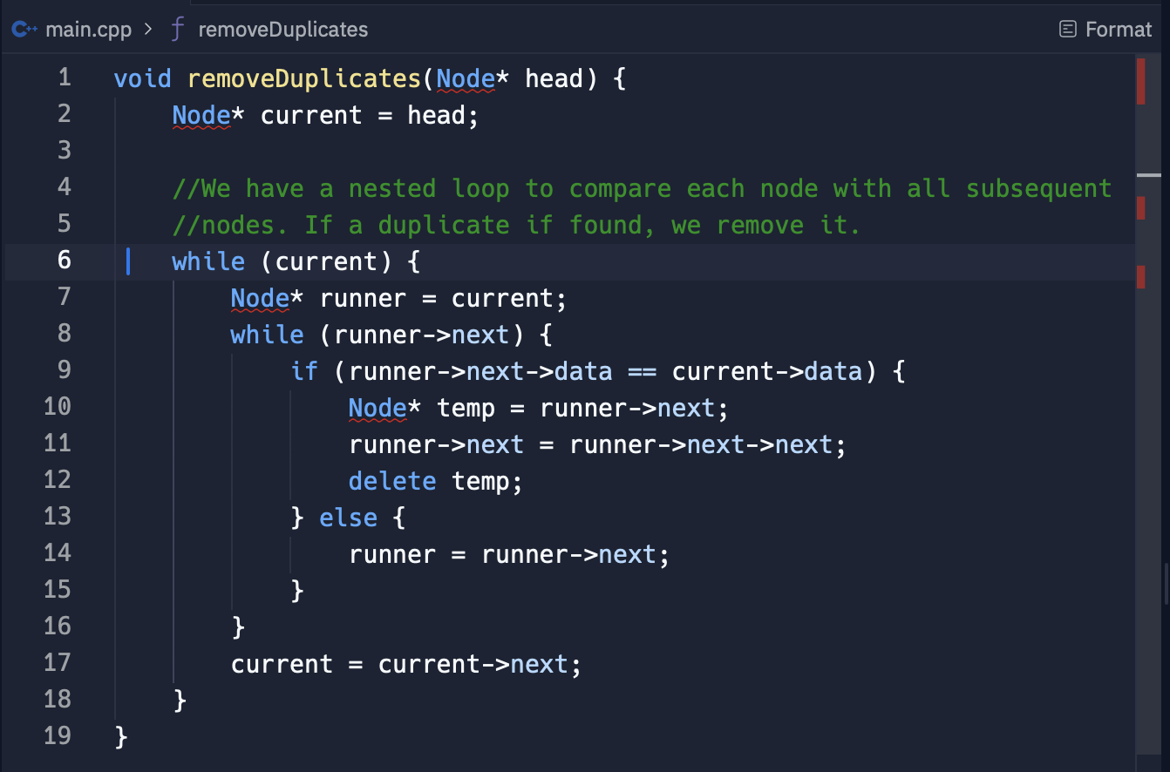
REMOVING DUPLICATES
TC = O(n^2)
SC = O(1)

Slide 9
RETurn kth to last: finding kth to the last element in linked list

Slide 10
Clarifications
RETURN KTH TO LAST
What should we return if the Kth element is out of bounds?
Can we assume the list is non-empty?
Discuss the trade off of each solution.

Slide 11
Solution 1#: using linked list size
RETURN KTH TO LAST

Slide 12
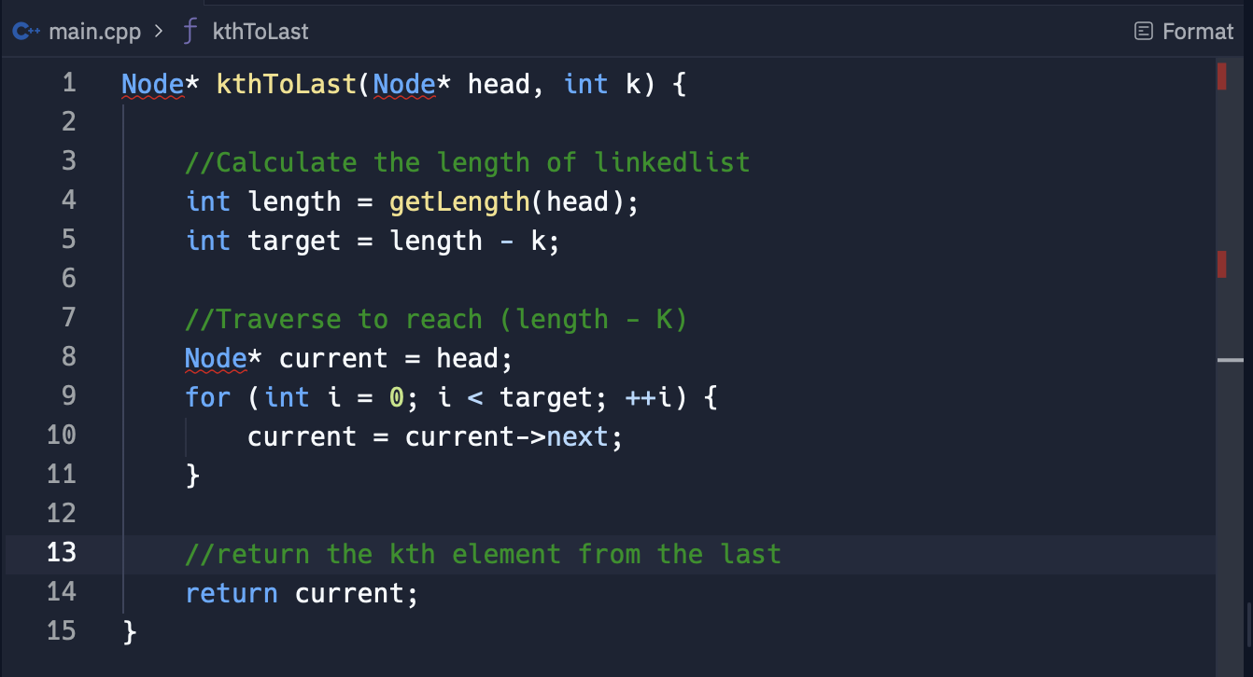
RETURN KTH TO LAST
Code
TC = O(n)
SC = O(1)

Slide 13
Solution 2#: Recursive Approach
RETURN KTH TO LAST

Slide 14
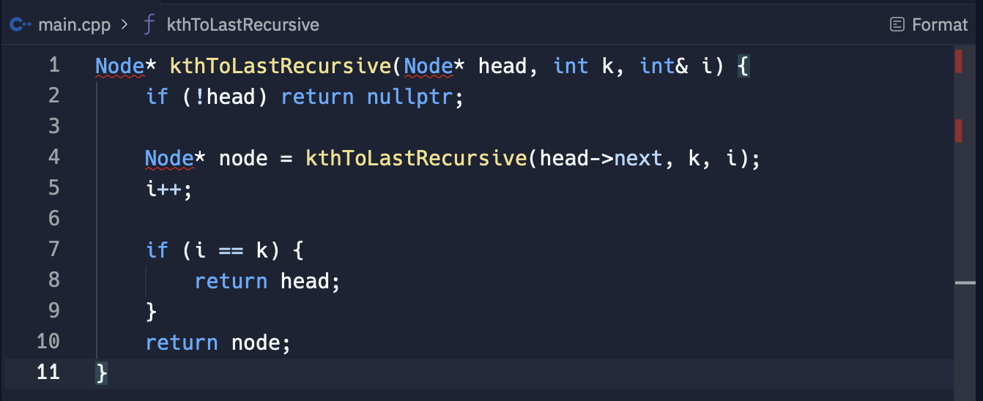
RETURN KTH TO LAST
Code
TC = O(n)
SC = O(n)

Slide 15
Solution 3#: TWO pointer technique
RETURN KTH TO LAST

Slide 16
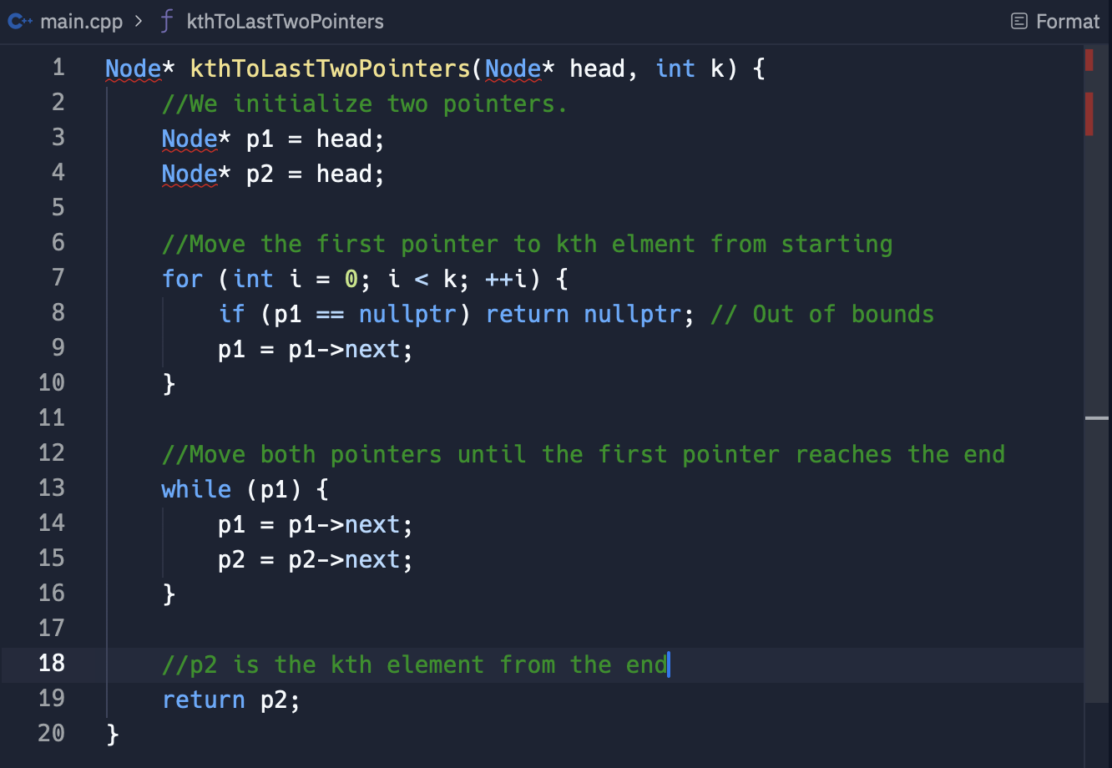
RETURN KTH TO LAST
Code
TC = O(n)
SC = O(1)

Slide 18
DELete middle node: deleting a node from middle of linked list

Slide 19
Clarifications
DELETE MIDDLE NODE
If the node to be deleted is not the last node.
If there are duplicate values
Implications of this approach, how the nodes original identity is lost as data is overwritten.

Slide 20
Solution 1#: Copy data from the next node
DELETE MIDDLE NODE

Slide 21
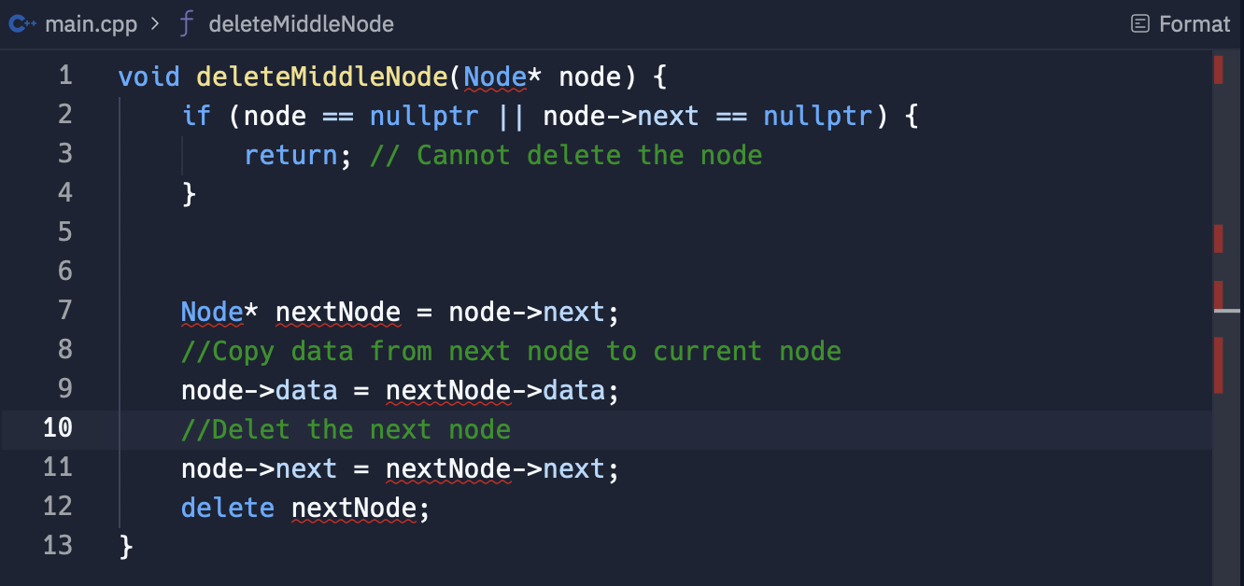
DELETE MIDDLE NODE
Code
TC = O(n)
SC = O(1)

Slide 23
Partition: Rearranging a linked list around a value

Slide 24
Clarifications
PARTITION
If the order within each partition needs to be preserved.
If the list contains multiple nodes with the value x.
If time permits, mention alternative approaches or optimizations, such as doing the partition in place without extra space for additional linked lists.

Slide 25
Solution 1#: TWO linked list approach
PARTITION

Slide 26
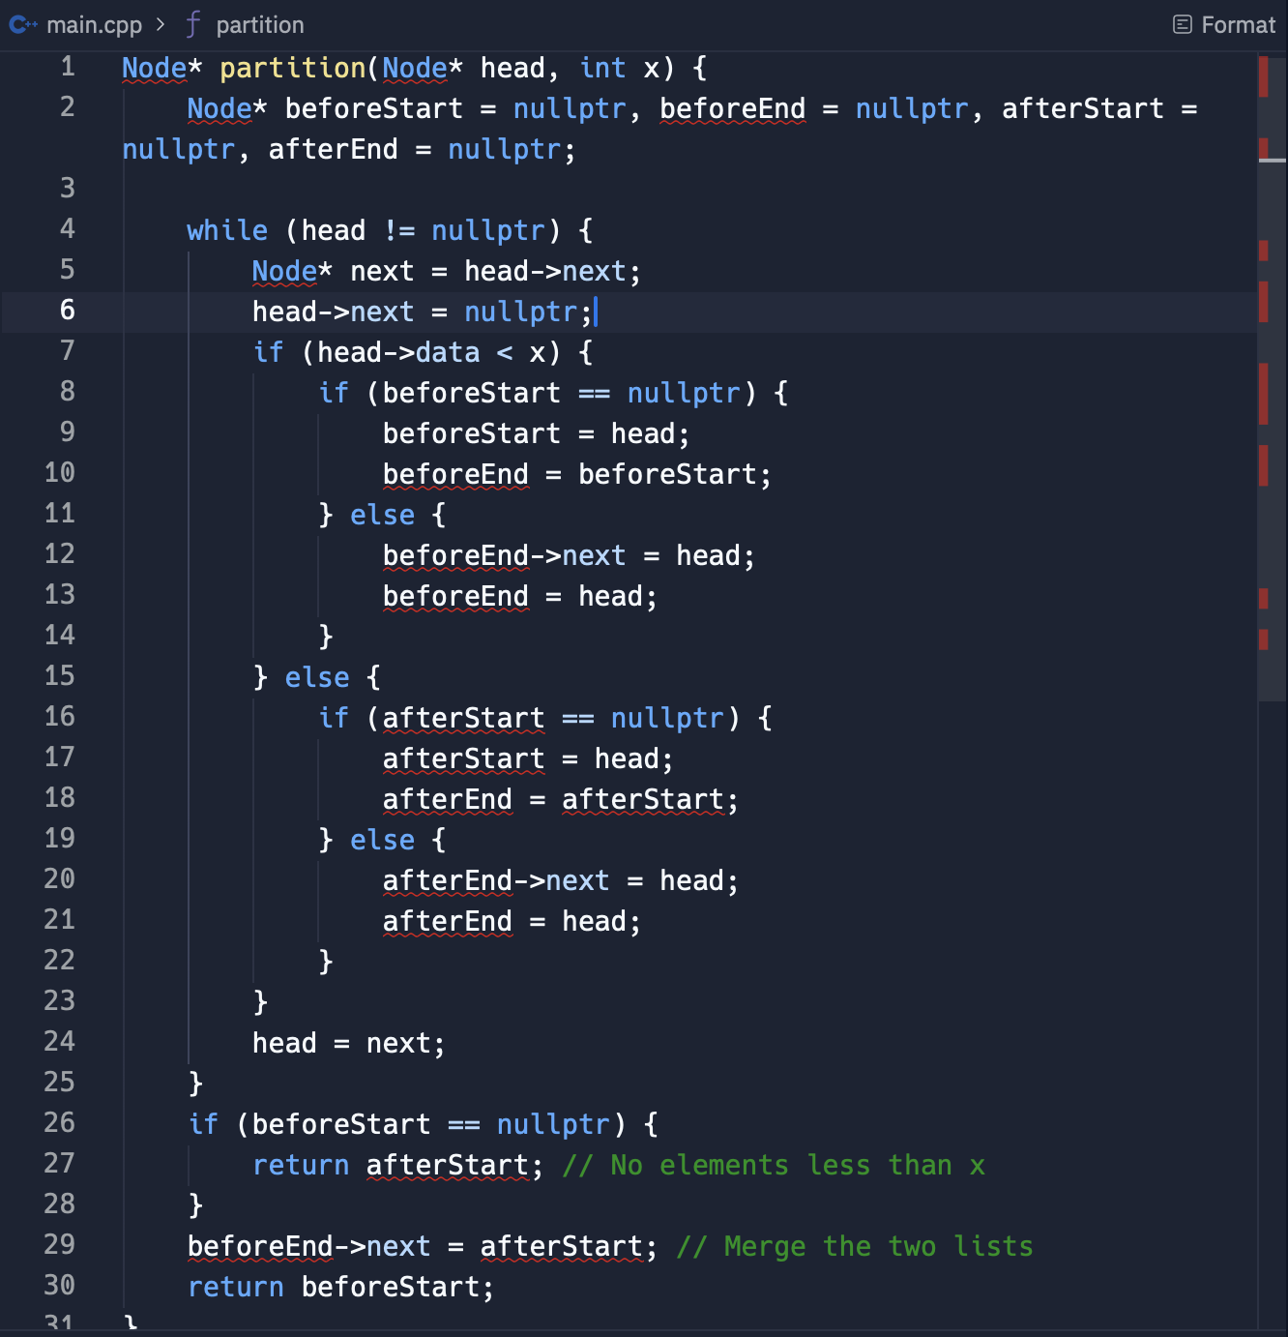
PARTITION
TC = O(n)
SC = O(1)

Slide 28
Sum lists: ADDING numbers represented by linked list

Slide 29
Part 1: digits are stored in reverse order
SUM LISTS

Slide 30
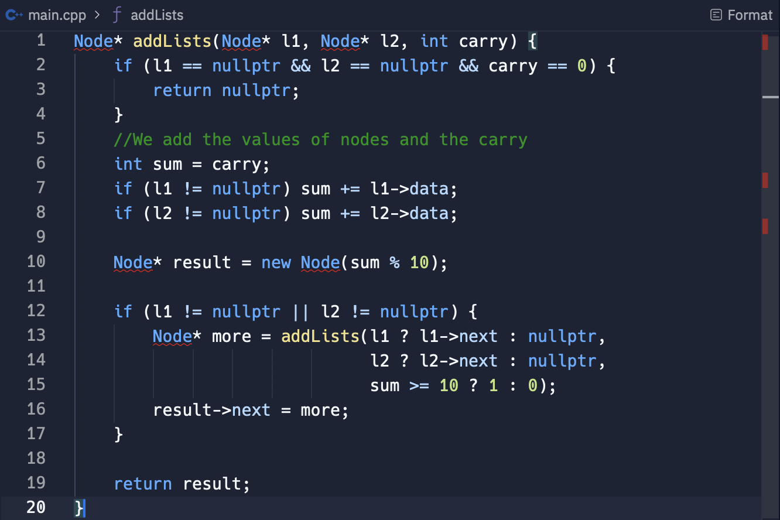
SUM LISTS
TC = O(n)
SC = O(n)

Slide 31
Part 2: digits are stored in forward order
SUM LISTS

Slide 32
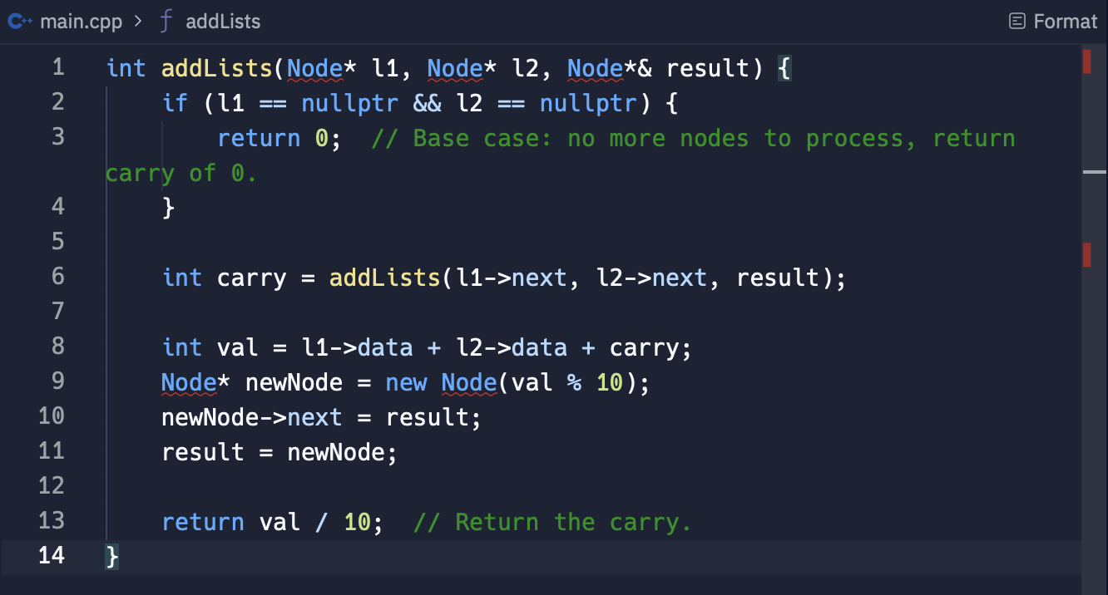
SUM LISTS
TC = O(n)
SC = O(n)

Slide 34
Palindrome check: Linked list

Slide 35
Clarifications
PALINDROME CHECK
Should the solution handle cases where the list is empty or has only one element?
Constraints on space complexity we have to consider?
How should the solution handle large lists or performance constraints?

Slide 36
Solution 1#: Reverse and compare
PALINDROME CHECK

Slide 37
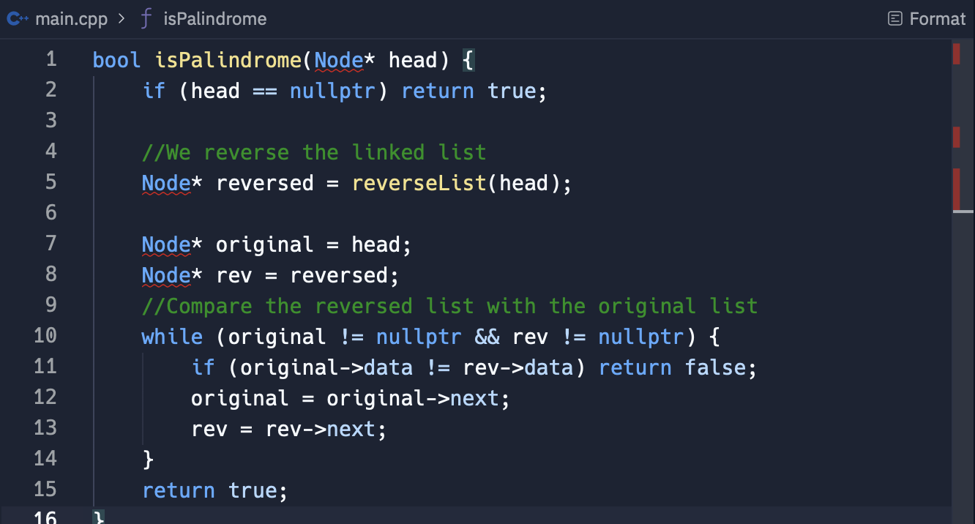
PALINDROME CHECK
TC = O(n)
SC = O(n)

Slide 38
Solution 2#: Reverse half using stack
PALINDROME CHECK

Slide 39
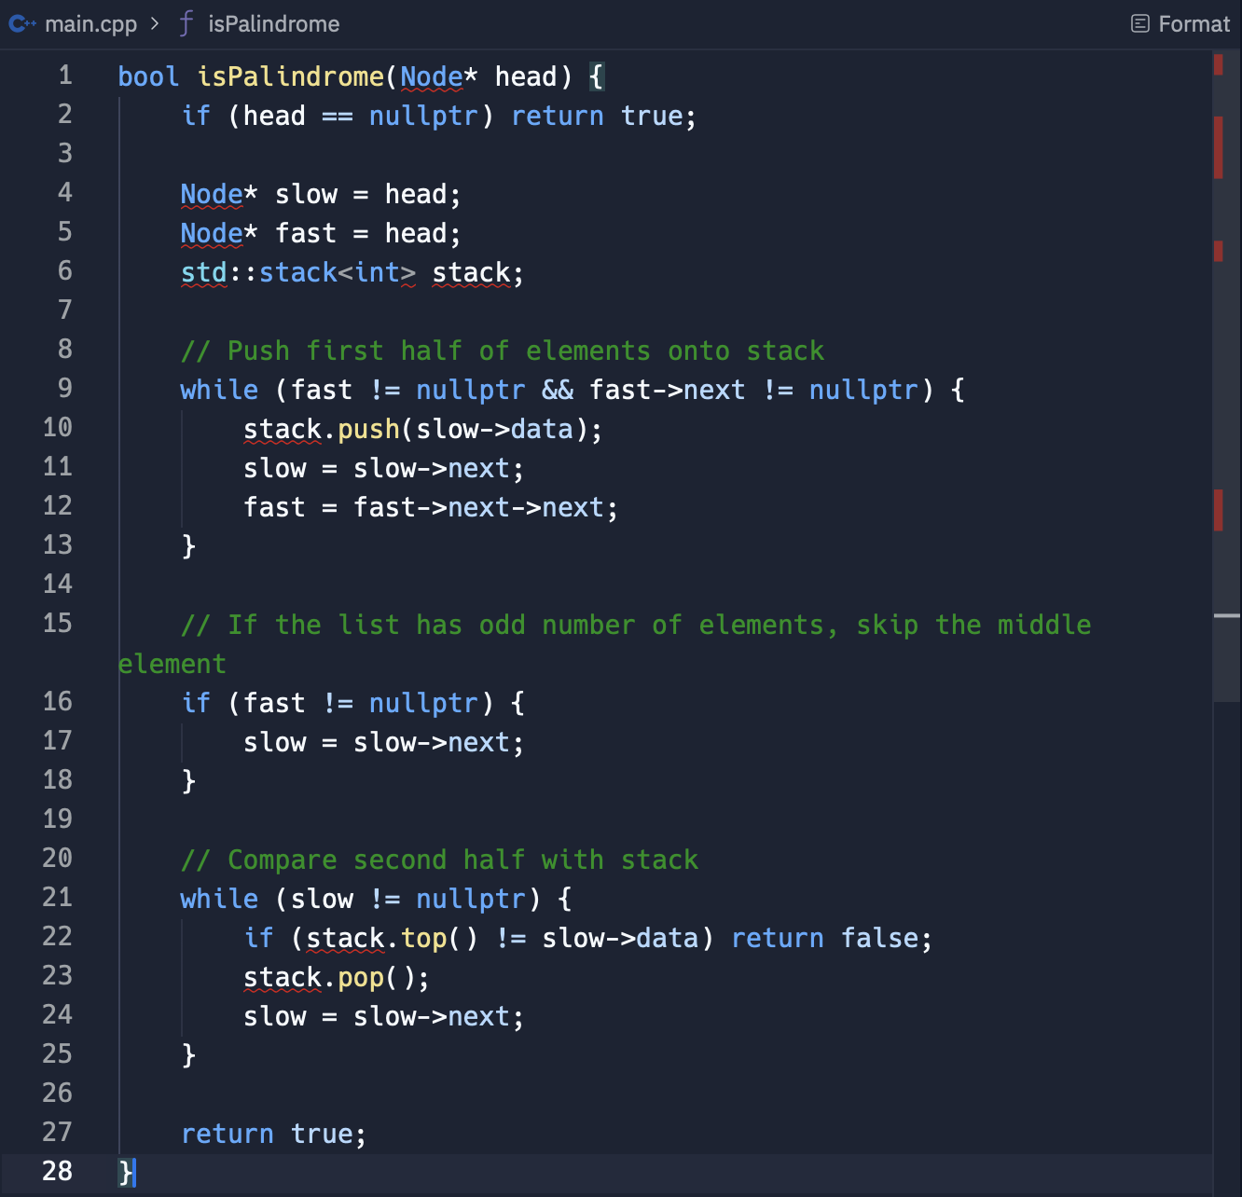
PALINDROME CHECK
TC = O(n)
SC = O(n)

Slide 40
Solution 3#: Recursive approach
PALINDROME CHECK

Slide 41
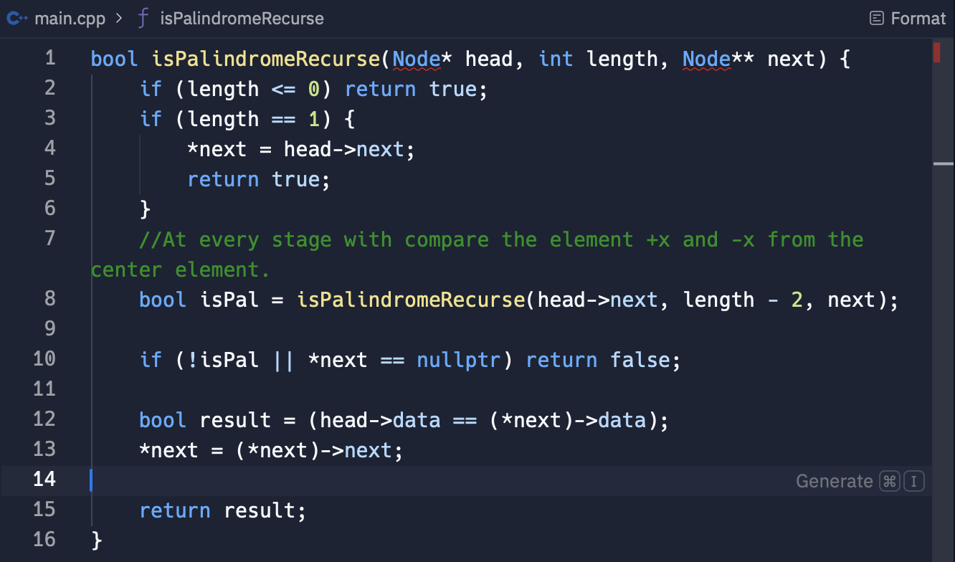
PALINDROME CHECK
TC = O(n)
SC = O(n)

Slide 43
Intersection: linked list

Slide 44
Clarifications
INTERSECTION
Should the solution handle cases where one or both lists are empty?
What is the maximum allowable length for the lists?
Are there any constraints on memory usage or performance?

Slide 45
Solution 1#: length and tail comparision
INTERSECTION

Slide 46
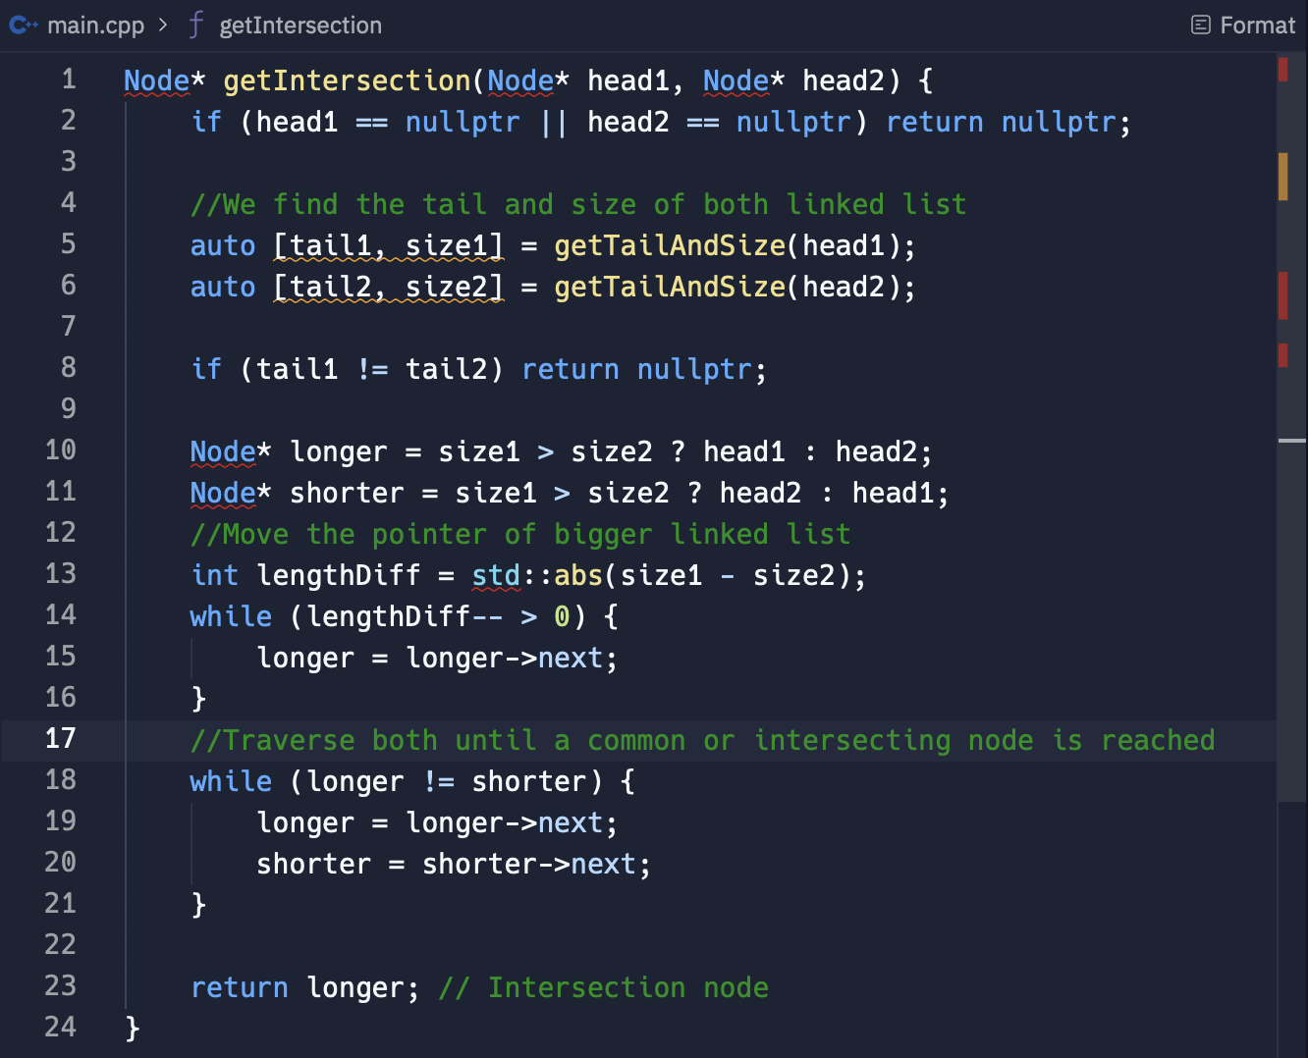
INTERSECTION
TC = O(n)
SC = O(1)

Slide 47
Solution 2#: Stack based approach
INTERSECTION

Slide 48
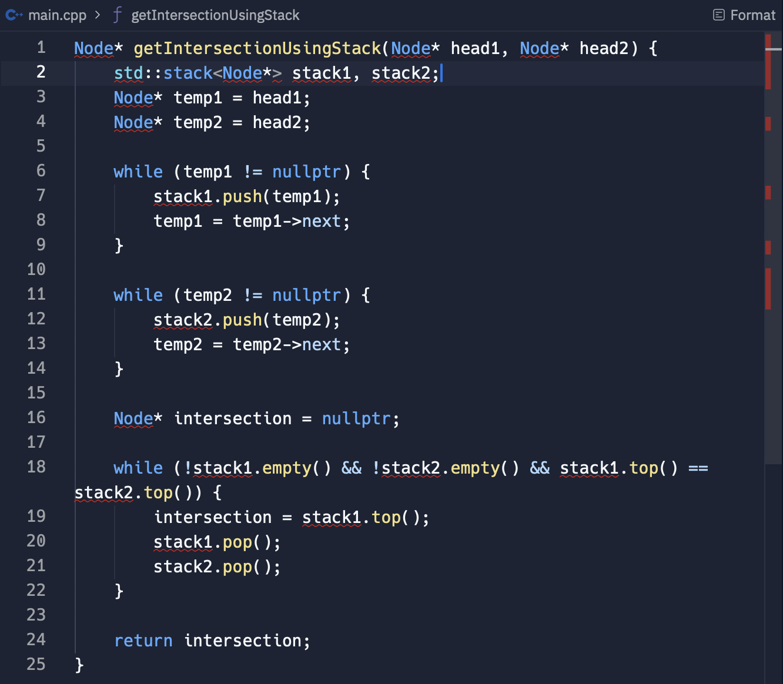
INTERSECTION
TC = O(n)
SC = O(n)

Slide 50
Loop detection: circular linked list

Slide 51
Clarifications
LOOP DETECTION
What is the list is very large and memory constraints are tight?
Are there any performance constraints or requirements?
Should you handle edge cases like an empty list or a list with no loop?

Slide 52
Solution 1#: Floyd’s cycle detection algorithm
LOOP DETECTION

Slide 53
Solution Approach
LOOP DETECTION
Step1: Initialize two pointers, Slow and Fast
Step 2: Move Fast pointer at 2 steps and slow pointer at 1 step
Step 3: When they collide, move slow pointer to the head
Step 4: Move both pointers one step at a time to find the loop start.

Slide 54
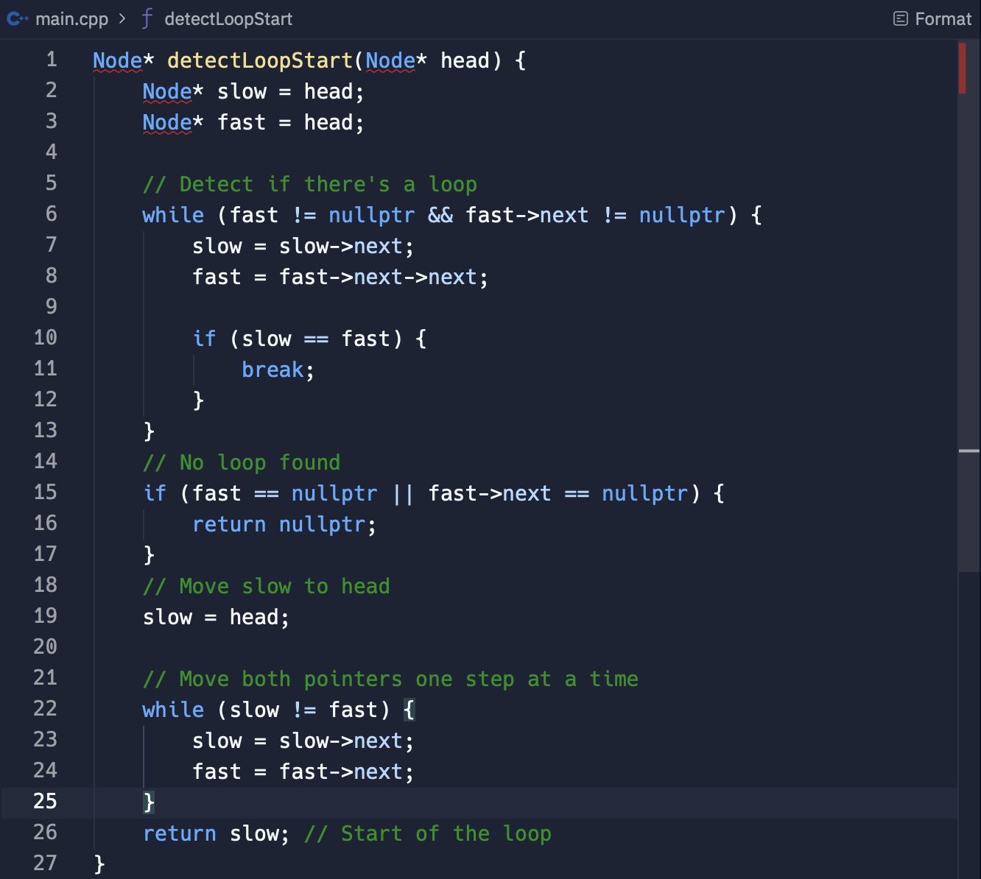
LOOP DETECTION
TC = O(n)
SC = O(1)

Slide 56
Remember to always ask clarifying questions before starting your solution.
Always think from a simple solution then build up from it.
Practise and revise as often as possible.

Slide 57
Thank you for watching!

